Slide 1
Requirement Management and Report Generation

Slide 2
Version Control and Revision History
 | Name | Date
Prepared By | Sneha Kumar | 07-Mar-2019
Reviewed By | Manisha Mane | 07-Mar-2019
Approved By | Nisha Mendonsa | 07-Mar-2019
Version No. | Date | Section Affected | Highlight of Changes
1.0.0 | 07-Mar-2019 | All | Original Version.

Slide 3
Requirement Traceability Matrix(RTM)
One of the key objectives of any testing venture is to ensure that the application under test is behaving as per the functional specification. To ensure this the key objective will be to test all the functionalities or the requirements as it is stated by the customer. Hence Test Coverage becomes a very critical metric for any Testing venture.
Requirement Traceability is very effective tool to ensure the test coverage. Traceability ensures completeness, that all lower level requirements
come from higher level requirements, and that all higher level requirements are allocated to lower level requirements. Traceability is also used to manage change and provides the basis for test planning.

Slide 4
Components
The following components should be mapped using the RTM so that all the test artifacts can be traced:
Test Requirement
Test Strategy
Test Plan
Test Scenario
Test Cases
Defect ids

Slide 5
Types of Traceability Test Matrix
Forward traceability looks at the following:
Tracing the business requirements to their resulting test requirement(s) to ensure the completeness of the product requirement specification.
Tracing each unique test requirement forward into the design or strategy that test that requirement, and the tests that validate that requirement and so on. The objective is to ensure that each requirement is thoroughly tested.
Backwards traceability looks at the following:
Tracing each Test back to its associated requirement. Backward traceability can verify that the requirements have been kept current with tests.
Tracing each requirement back to its source(s).

Slide 6
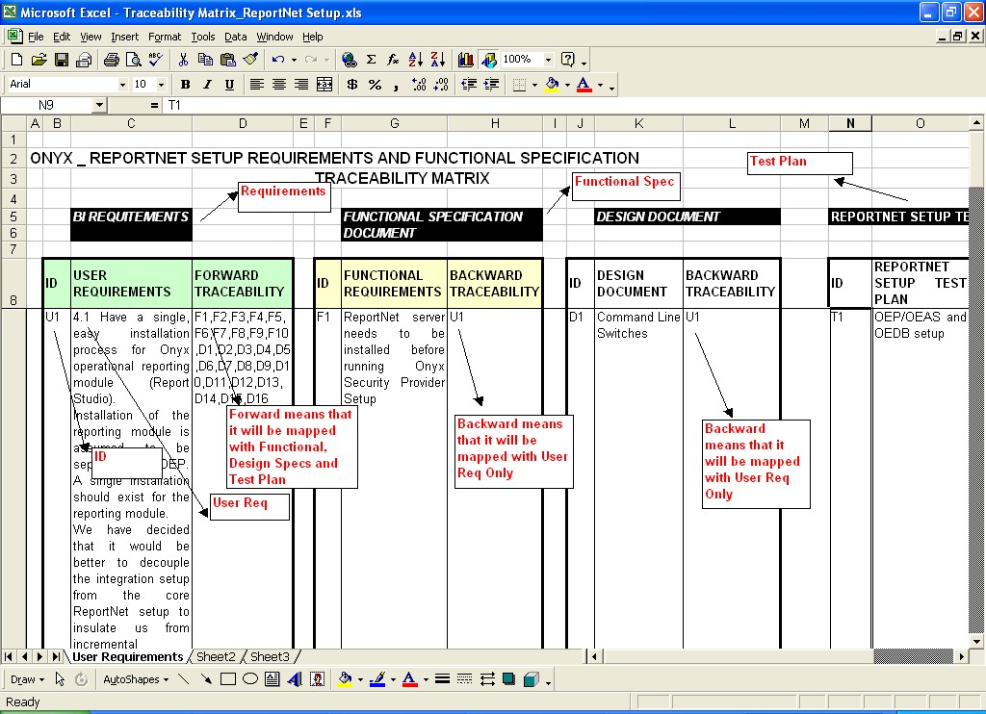

Slide 7
Configuration Management
Chapter 1

Slide 8
Configuration Management
The purpose of configuration management is to establish and maintain the integrity of the products (Components, data and documentation) of the software or system through the project and product life cycle.
Configuration Management (CM) is a "set of activities designed to control change by identifying the work products that are likely to change, establishing relationships among them, defining mechanisms for managing different versions of these work products, controlling the changes imposed, and auditing and reporting on the changes made.“

Slide 9
IMPORTANT SCM ACTIVITIES
Identifying and organizing the software configurable items
Maintaining change requests and systematically controlling the changes to the configurable items
Tracking the status of the Configurable items
Review and Audit of the software configuration management activities

Slide 10
The testers need to know two aspects of change.
The characteristics of the change so that modification to the test plan and test data can be made to assure the right functionality and structure are tested.
The version in which that change will be implemented

Slide 11
Configurable Vs Non-Configurable Items
Project may contain Configurable items(CI) as well as Non Configurable items(Non-CI)
Example for Configurable Items:
1.Test Plan
2.Test case Design
Example for Non-Configurable Items:
1.MOM
2.Weekly status report

Slide 12
Process involved in SCM
Forming SCM Team
Creating Project Library structure
Define and create User groups and Access control
Archival of Project Items

Slide 13
Forming SCM TEAM
Team which takes care of SCM Activities by creating PROJECT LIBRARY STRUCTURE
Some benefits of SCM Tool
Keep back up of all work products
Track which person changes what and when
Doesn’t allow more than one person to make modifications at the same time
Helps the Top level management to Track progress

Slide 14
Define and create User groups and Access Control
User Groups Access Control
Management Read
SCM Coordinator/PL Full Control
TL Read/Write
Team members Read/Write

Slide 15
Archival of the Project item
Maintaining Hardcopies and softcopies of the work products

Slide 16
Queries

Slide 17
Thank You.

